Slide 1
Bottom-Up Parsing
Hiwot Belay Mekonnen
BDU1506583
Principles of Compiler Design

Slide 2
Agenda
Introduction
Definition and Concept
The Process
Different Approaches
Pros and cons
Conclusion
References

Slide 3

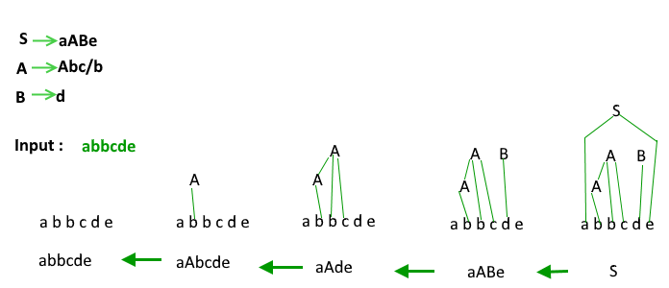
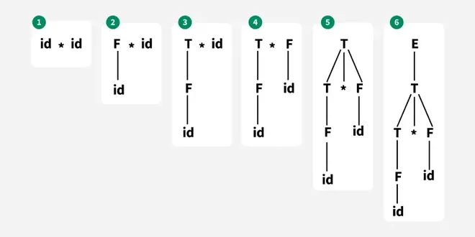
Overcoming nervousness
Confidence-building strategies

Slide 4
Introduction - What is Parsing?
Before we talk about bottom-up parsing, let's understand what parsing means.
Parsing is the process of analyzing a string of tokens to determine its grammatical structure according to a given grammar.
There are two main approaches:
Top-down parsing - starts from the start symbol and works down
Bottom-up parsing - starts from the input tokens and works up

Slide 5
Bottom-Up Parsing
Bottom-up parsing is a parsing technique that builds the parse tree from the leaves (bottom) to the root (top).
Instead of starting with the grammar's start symbol, it:
1. Starts with the actual input tokens (the leaves)
2. Tries to match them with grammar rules
3. Builds up to the start symbol (the root)
The name "bottom-up" comes from building the parse tree from the bottom (input tokens) upward to the top (start symbol).

Slide 6
How Bottom-Up Parsing Works?
The basic idea is simple:
1. Read tokens from the input one by one
2. Look for patterns that match the right-hand side of grammar rules
3. Reduce those patterns to the left-hand side non-terminal
4. Repeat until you reach the start symbol
This is also called shift-reduce parsing because you:
Shift: move tokens onto a stack
Reduce: replace a pattern on the stack with a non-terminal
If you successfully reduce everything to the start symbol, the input is valid. If you can't, there's a syntax error.

Slide 7
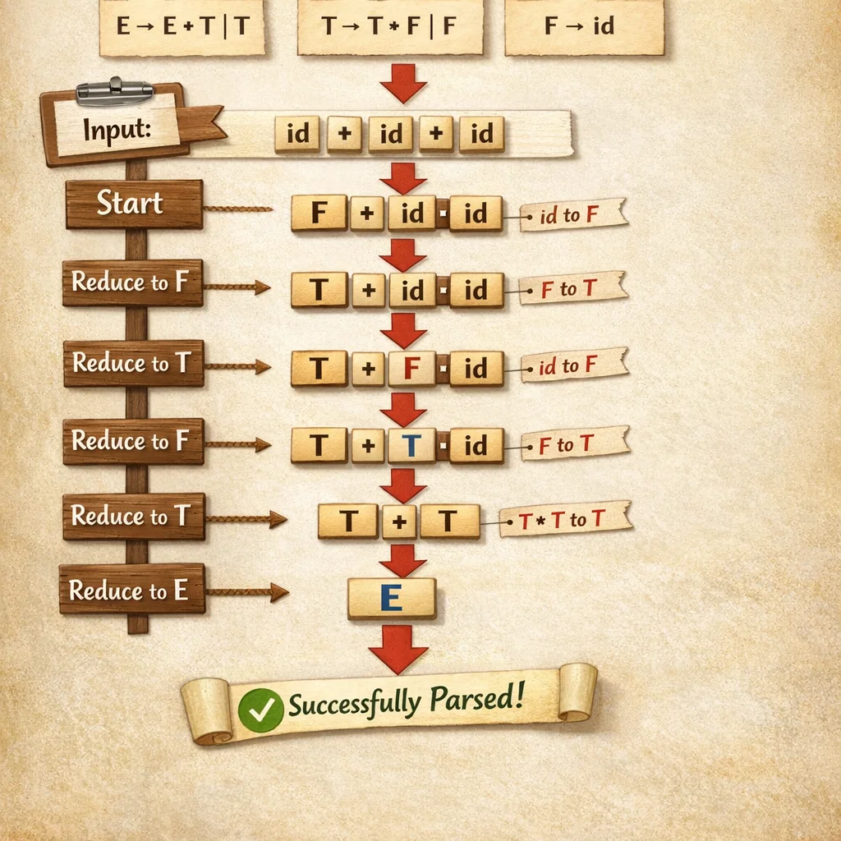
Example - Simple Grammar
Let's see a simple example. Consider this grammar:
E → E + T | T
T → T * F | F
F → id
And the input: id + id * id

Slide 8
Types of Bottom-Up Parsing
1. LR Parsers (Left-to-right, Rightmost derivation)
Most common type, Reads input from left to right,Uses a parse table to decide actions
2. Operator Precedence Parsing
Used for expressions, Based on operator precedence, Simpler but less powerful
3. Shift-Reduce Parsing
General technique, Uses a stack and input buffer, Makes shift or reduce decisions
The most important one is LR parsing, which is what most real compilers use.

Slide 9
Pros and Cons
Advantages of Bottom-Up Parsing
1. More Powerful
2. Efficient
3. Widely Used
4. Better Error Handling
5. Handles Ambiguity
Disadvantages and Limitations
1. Complex to Implement Manually
2. Grammar Requirements
3. Less Intuitive
4. Tool Dependency
Despite these limitations, the advantages make it the preferred choice for most compilers.

Slide 10
Bottom-Up vs Top-Down Parsing
Bottom-Up Parsing:
Starts from input tokens
Builds tree from leaves to root
More powerful - can handle more grammars
Used by most production compilers
Examples: LR, LALR parsers
Top-Down Parsing:
Starts from start symbol
Builds tree from root to leaves
Simpler to understand
Limited to LL grammars
Examples: Recursive descent, LL parsers
Why bottom-up is preferred: Can handle left-recursive grammars (top-down can't), More efficient for large languages, Better error recovery

Slide 11
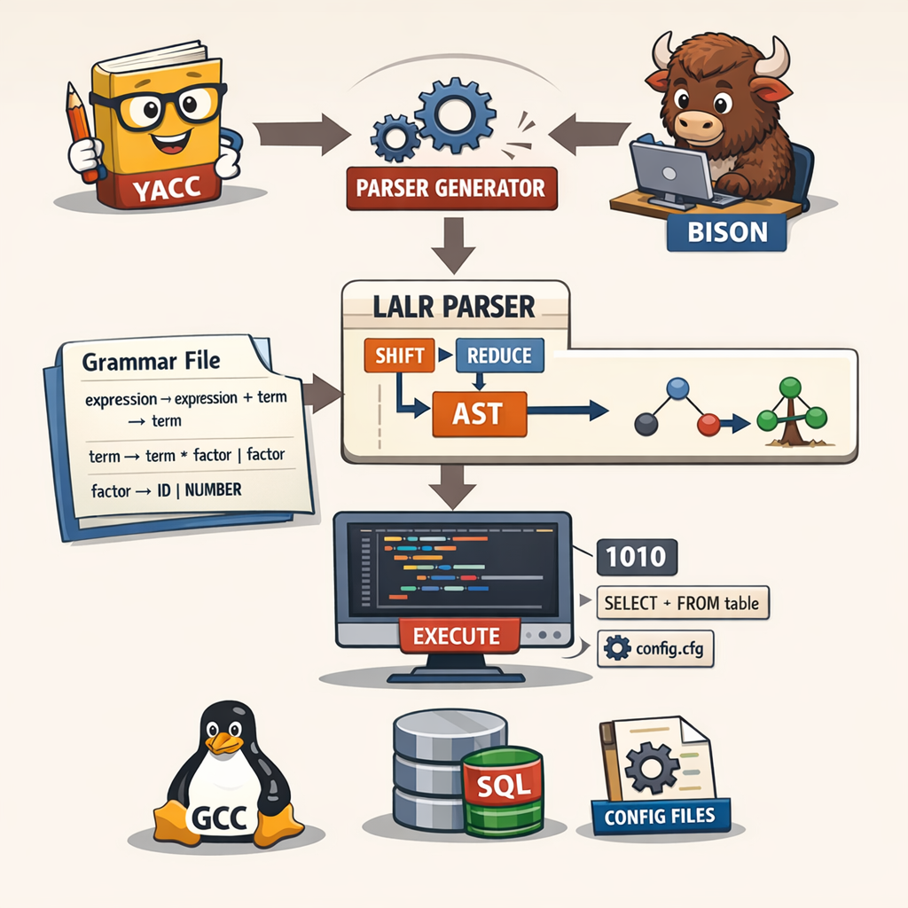
Real-World Application - Yacc/Bison
Yacc (Yet Another Compiler Compiler) and Bison are parser generators that use bottom-up parsing.
How they work:
1. You write a grammar file
2. Yacc/Bison generates a parser (usually LALR)
3. The parser can be used in your compiler

Slide 12
Case Study - How Compilers Use It
Let's look at how a real compiler uses bottom-up parsing:
Example: C Compiler
1. Lexical Analysis: Converts source code to tokens
int x = 5; becomes: INT ID ASSIGN NUMBER SEMICOLON`
2. Syntax Analysis (Bottom-Up Parser):
Uses LR/LALR parser, Checks if tokens form valid C syntax, Builds parse tree
3. Semantic Analysis: Checks meaning
4. Code Generation: Produces machine code

Slide 13
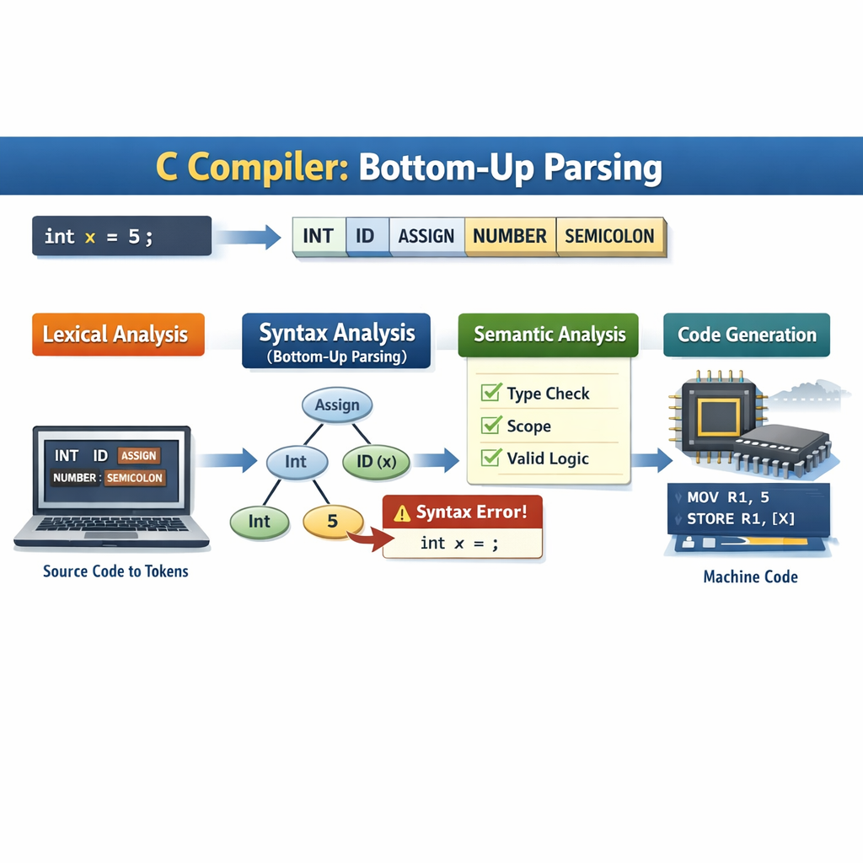
Speaking impact
Your ability to communicate effectively will leave a lasting impact on your audience
Effectively communicating involves not only delivering a message but also resonating with the experiences, values, and emotions of those listening

Slide 14
Conclusion
Bottom-up parsing is a fundamental technique in compiler design. It's the method most real-world compilers use because it's powerful, efficient, and can handle complex grammars.
Understanding bottom-up parsing helps us appreciate:
How compilers work
Why certain syntax rules exist
How parser generators like Bison function
The importance of grammar design
While it may seem complex, tools like Bison make it accessible, and understanding the concept helps in writing better compilers and understanding language design.

Slide 15
References
1. Aho, A. V., Lam, M. S., Sethi, R., & Ullman, J. D. (2006). _Compilers: Principles, Techniques, and Tools_ (2nd ed.). Pearson Education. (The "Dragon Book")
2. Cooper, K. D., & Torczon, L. (2011). _Engineering a Compiler_ (2nd ed.). Morgan Kaufmann.
3. Levine, J. R. (2009). _flex & bison: Text Processing Tools_. O'Reilly Media.
4. Wikipedia Contributors. (2023). "LR parser." Wikipedia, The Free Encyclopedia. https://en.wikipedia.org/wiki/LR_parser
5. GeeksforGeeks. (2023). "Bottom-up or Shift Reduce Parsers." https://www.geeksforgeeks.org/bottom-up-or-shift-reduce-parsers-set-2/

Slide 16
Thank you

